Slide 1
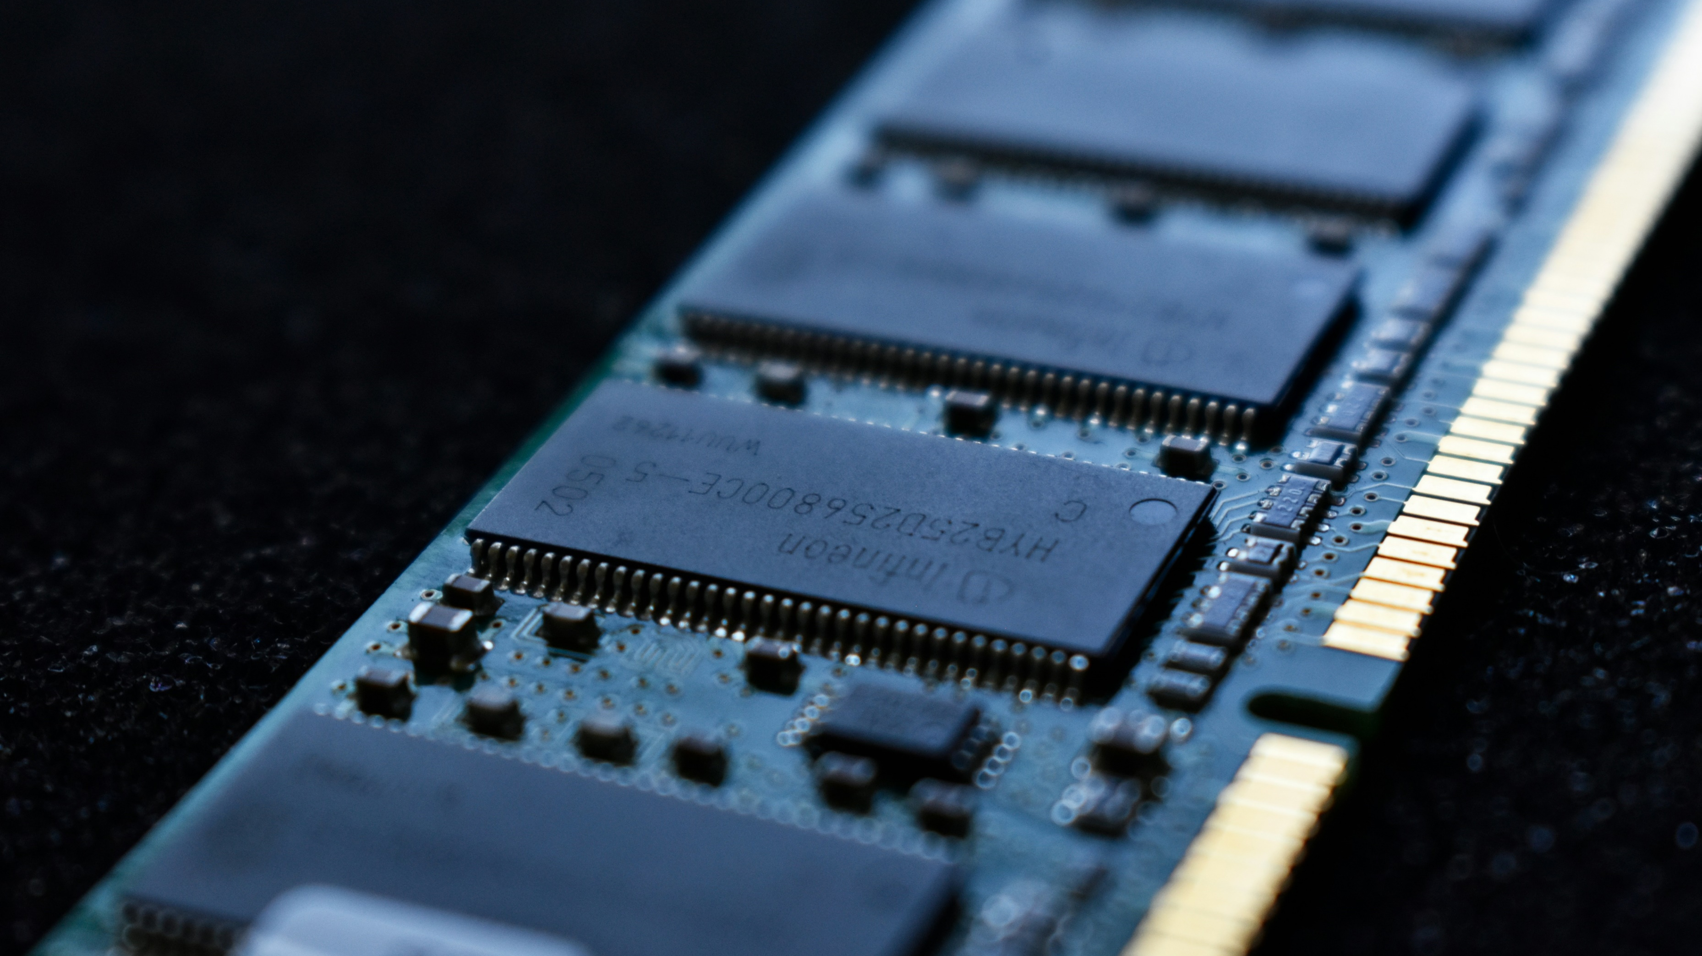
Memory Forensics

Slide 2
Memory Basics
Memory Vs Storage? (Freshman/Sophomore)
What is RAM?
Since it is volatile, what complications could you run into in obtaining it?
What are other things a DFIR Analyst might do that could change the RAM?
Plugging in a USB to dump the RAM, no write-blockers when cloning, etc.
Does that make capturing RAM futile? No just document it.

Slide 3
Memory Basics
There are three things you need to do when you first go to capture the drive/RAM:
Determine the OS Version (i.e. Windows 11 22H2). Why?
Determine if the Disk is Encrypted. Anyone (not those in DFIR) know why we would need to know this for Memory Forensics?
CAPTURE THE RAM!!!
What kind of things are in RAM?
Any type of process, most applications you run, decryption keys, envvars, frequently accessed files, loaded dlls, some cmd history

Slide 4
Capturing RAM
The ways that I have found:
If it’s a VM:
VBOX: https://kollee.github.io/posts/memory-forensics-of-a-virtualbox-vm/
VMWare: https://kb.vmware.com/s/article/2003941
BelkaSoft RAMCapturer and other tools (DumpIt, FTKImager,etc.)

Slide 5
Capturing DAT RAM (Follow Along)

Slide 6
Analyzing the RAM w/ Volatility
Take a look at the pslist results.
The first two values for each entry are “PID” and “PPID” (as shown in the column names at the top of the results). What are those?
PID is the Process ID number for that particular process.
PPID is the Parent Process ID number, meaning the process that launched this process.
How can we use this?

Slide 7
Memory Forensics Challenges
Challenges
https://github.com/stuxnet999/MemLabs
Resources to help with Volatility
https://blog.onfvp.com/post/volatility-cheatsheet/

